Slide 1
Software Process Simulation Modeling

Slide 2
Software Process Simulation Modeling
Software Process Simulation Modeling (SPSM) is the use of computational algorithms and mathematical representations to imitate the dynamic behavior of software development processes. It enables project managers to test "what-if" scenarios, optimize workflows, predict project outcomes, and mitigate risks in a virtual, risk-free environment.

Slide 3
When to Apply It
SPSM can be adapted for a wide variety of software scopes, ranging from micro-processes (like an individual sprint) to long-term macro-projects (like a multi-year product evolution). It is highly beneficial when analytic models fall short due to complex, cascading decisions (e.g., assessing whether the cost of hiring new developers outweighs the time spent training them)

Slide 4
Software Development As A Process
In simulation modeling, software development as a process means developing a simulation software/system through a structured series of stages to represent, analyze, and improve a real-world system.
A typical software development process for simulation modeling includes:
1. Problem Formulation
Identify the real-world system to be simulated.
Define objectives, scope, assumptions, and performance measures.
Example: Simulating a bank queue to reduce customer waiting time.
2. System Analysis
Study how the real system works.
Identify:
Inputs
Processes
Outputs
Relationships among components
3. Model Design (Conceptual Modeling)
Create an abstract representation of the system.
Define:
Entities
Resources
Events
Variables
Rules and logic

Slide 5
4. Data Collection and Analysis
Collect required real-world data.
Determine input parameters and probability distributions.
Example:
Arrival rate of customers
Service time distribution
5. Model Translation / Coding
Convert the conceptual model into a computer simulation program.
Use simulation languages/tools such as:
MATLAB
AnyLogic
Arena Simulation Software
Simul8
6. Verification
Check whether the simulation program is implemented correctly.
Question: "Did we build the model correctly?"
7. Validation
Compare simulation results with the real system.
Check whether the model represents reality.
Question: "Did we build the correct model?"

Slide 6
8. Experimentation
Run simulation experiments with different conditions.
Change parameters and observe outcomes.
Example:
Increase number of servers
Change arrival rate
9. Result Analysis and Interpretation
Analyze simulation outputs.
Identify improvements and make decisions.
10. Documentation and Implementation
Prepare reports and documentation.
Apply simulation findings to the real system.

Slide 7
Problem Definition
↓
System Analysis
↓
Conceptual Model
↓
Data Collection
↓
Model Coding
↓
Verification
↓
Validation
↓
Experimentation
↓
Result Analysis
↓
Implementation

Slide 8
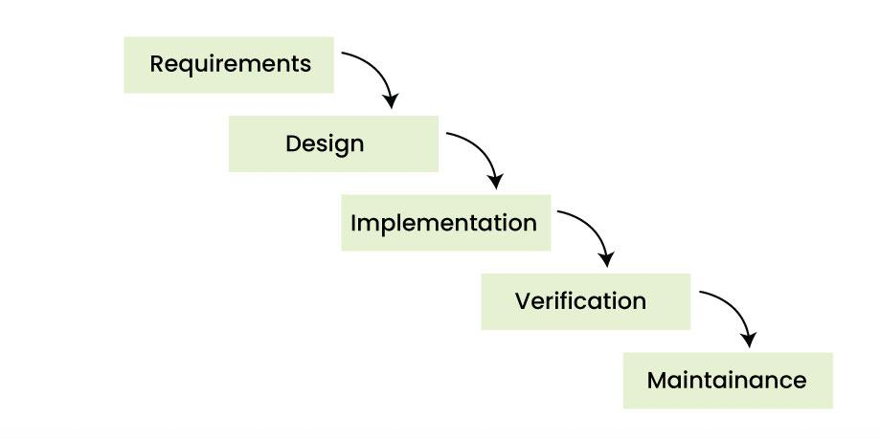
Software Development as a Process: Waterfall Model

Slide 9
The Waterfall Model is a linear and sequential software development process used for developing simulation software. The development moves step-by-step through different phases, and each phase is completed before the next begins.
In simulation modeling, the waterfall model ensures a systematic approach from defining the problem to developing and using the simulation model.
1. Requirements / Problem Definition
Identify the simulation problem and objectives.
Define system boundaries, assumptions, and required outputs.

Slide 10
2. System Analysis
Study the real-world system.
Identify:
Entities
Variables
Events
Resources
Relationships
3. System Design
Prepare the simulation model structure.
Design algorithms, data flow, and model logic.
4. Implementation (Coding)
Convert the simulation design into a computer program.
Develop simulation modules using programming languages or simulation tools.
5. Testing
Test the simulation software.
Includes:
Verification: Checking whether the model is built correctly.
Validation: Checking whether the model represents the real system.

Slide 11
6. Deployment
Implement the simulation software for users.
Run simulation experiments and generate results.
7. Maintenance
Update the simulation model.
Fix errors and modify according to new requirements.
Advantages:
Simple and easy to manage.
Clear phases and documentation.
Suitable when simulation requirements are well-defined.
Disadvantages:
Difficult to modify earlier stages.
Less flexible for changing systems.
Errors found late may require major changes.

Slide 12
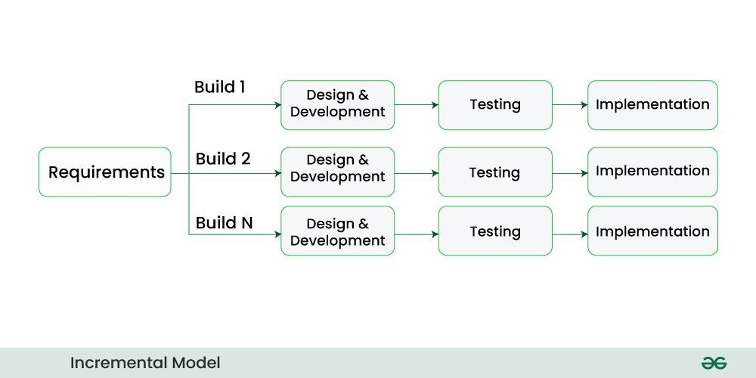
Incremental Model

Slide 13
Incremental Model
In Incremental Model, the Software Development Process is divided into several increments and the same phases are followed in each increment. In simple language, under this model a complex project is developed in many modules or builds.
For example, we collect the customer's requirements, now instead of making the entire software at once, we first take some requirements and based on them create a module or function of the software and deliver it to the customer. Then we take some more requirements and based on them add another module to that software.
Similarly, modules are added to the software in each increment until the complete system is created. However, the requirements for making a complex project in multiple iterations/parts should be clear.
If we understand the entire principle of Incremental methodology, then it starts by developing an initial implementation, then user feedback is taken on it, and it is developed through several versions until an accepted system is developed. Important functionalities of the software are developed in the initial iterations.
Each subsequent release of a software module adds functions to the previous release. This process continues until the final software is obtained.

Slide 14
Modeling the Software Development Process
means representing how software is planned, designed, built, tested, and maintained using a structured model. It helps in understanding, analyzing, and improving the development lifecycle.
used in simulation studies to understand:Development time Cost estimation Productivity Software quality Team performance
The model is based on two main factors:
1. Performance Refers to the effort and productivity of a developer.
Indicates how fast and efficiently a developer works.
Depends on:
Motivation
Work rate
Individual effort level
Higher performance → more output in less time.
2. Knowledge Competence Refers to the level of understanding and skills a developer has.
Includes:
Programming knowledge
Domain knowledge Tools and technologies
Requirements understanding
Higher knowledge → better decision-making and fewer errors.
High Performance + High Knowledge Competence = High Quality Software

Slide 15
Effort Performance Model (EPM)
The Effort Performance Model (EPM) is a software development process model that represents the relationship between development effort, resources, and performance of a software project.
It is used to estimate how much effort is required to complete software activities and how effort affects project performance.
The Effort–Performance Model (EPM), developed by Rasch and Tosi, is a conceptual framework that explains how software developer performance is influenced by effort and other psychological and personal factors. It integrates ideas from Expectancy Theory, Goal-Setting Theory, and Individual Characteristics to better understand developer behavior and productivity.
According to Expectancy Theory, individuals who are highly motivated tend to exert more effort, which leads to higher performance. Performance is related to factors such as effort level, ability, and role perception. This means that if a developer believes their effort will lead to good results, they will work harder and perform better.
Goal-Setting Theory explains that performance depends on the clarity and difficulty of goals. Clear goals improve focus and reduce confusion, while challenging but achievable goals increase effort and enhance performance. On the other hand, unclear goals reduce performance due to hesitation and lack of direction.
The model also includes Individual Characteristics, which refer to personal traits such as need for achievement, locus of control, and self-esteem. These characteristics influence how much effort a developer is willing to invest in a task and how they respond to challenges.
EPM also includes Individual Characteristics such as need for achievement, locus of control, and self-esteem, which affect how much effort a developer puts into work.
EPM shows that developer performance depends on motivation, goals, and personality, with ability being the strongest factor.

Slide 16
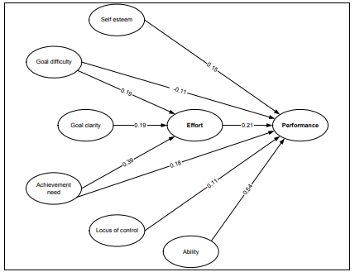
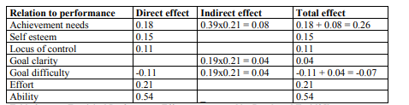
Effort Performance Model (EPM)

Slide 17
Knowledge Model (HKM),
The Knowledge Model (HKM), developed by Hanakawa et al., is a simulation-based model that explains how a software developer’s knowledge changes over time while working on tasks. It is based on the idea of a learning curve, meaning that a developer’s knowledge increases as they gain experience from performing tasks.
In this model, a developer’s knowledge is represented using an individual knowledge structure, often shown as a cognitive map (graph structure). In this graph, nodes represent knowledge elements such as SQL or Relational Database (RDB), while links show the prerequisite relationships between these knowledge areas. This helps in understanding how one type of knowledge depends on another.
The model introduces two important parameters: adequacy of knowledge and workload. Adequacy of knowledge refers to how much knowledge a developer has in a specific area, usually measured as a percentage. It can be evaluated through tests or based on experience. Workload refers to the amount of work that requires a specific type of knowledge and is estimated from past project data by analyzing artefacts like design documents and identifying which knowledge areas were used.
HKM also explains how knowledge is gained during task execution. If a developer’s current knowledge is lower than the required knowledge for a task, then working on that task increases their knowledge. However, if the developer already has equal or higher knowledge, there is no significant knowledge gain. Similarly, if the task is too difficult compared to the developer’s knowledge, the learning gain becomes very small.
The model is mathematically defined using a knowledge gain function, where knowledge gained depends on task requirement, existing knowledge, workload, and learning rate. After each task, the developer’s knowledge level is updated by adding the gained knowledge to the previous level, showing continuous learning over time.

Slide 18
Artefact Quality Model (AQM)
The Artefact Quality Model (AQM) explains how the quality and size of software artefacts (such as documents, code, or designs) are influenced by developer performance, ability, and contribution over time. Since quality is difficult to measure directly, the model relates it to more observable factors like knowledge (ability) and experience. In this framework, experience helps refine knowledge by adding practical understanding, while knowledge provides theoretical foundations. For modeling purposes, both knowledge and experience are combined into a single factor called ability.
In AQM, an artefact is produced through multiple activities performed by one or more developers. The size of an artefact depends on the total contribution made by developers, where each contribution is influenced by performance and the time spent on the task. Therefore, higher performance and longer duration generally increase the artefact size.
The quality of an artefact is linked to the ability of developers contributing to it. Each sub-activity has a quality value based on the weighted contribution of developers’ abilities. Since different parts of an artefact may have different importance, weights are used to represent the relative importance of each sub-activity, resulting in an overall artefact quality measure.
AQM is also integrated with other models such as EPM and HKM. In this integration, ability is represented using knowledge level from HKM, while task difficulty is defined as the difference between required knowledge and actual knowledge. Task clarity is determined by the quality of previous artefacts, meaning better-quality input leads to clearer tasks. This integration helps connect developer knowledge, effort, and artefact quality in a single framework.

Slide 19
MULTI AGENT-BASED SIMULATION MODEL
an agent is a computer system that exists in an environment and is capable of autonomous action within that environment to achieve its design objectives. This means the agent can operate independently, interact with its environment, and take actions to fulfill its goals.
an agent-based solution to be appropriate when the problem has one or more of the following characteristics: -
-The Environment is open, highly dynamic, uncertain or complex.
- Agents provide for a natural metaphor in solving the problem.
- Data, control or expertise is distribute
in practice, the exact definition of an agent is not very important. What matters more is the usefulness (utility) of the agent concept in modeling real systems.
The main idea is that the agency paradigm is used because it helps represent real-world situations in a simple and meaningful way. In this study, developers are modeled as agents because they behave like partially autonomous individuals in software development.
However, developer autonomy is limited. They cannot refuse tasks assigned by management, but they may refuse to work during weekends and holidays. This shows that agents are not fully autonomous, but only autonomous enough to realistically represent developers while still meeting the objectives of the simulation model(So our agent is sufficiently autonomous, but not more, “to meet its design objectives).

Slide 20
Situation (environment)
The environment in which our agents “evolve” is a “world” of artefacts with which they interact. The development process and a time dimension structure this ”world”.
Artefacts
Artefacts are the various requirements, specifications and code that are submitted to the developer at the beginning of each phase for him to use as a platform to develop the artefacts of the next phase.
Process
The process defines the set of input that the developer (agent) will use, at a given phase, and what artefacts are expected as output of this phase.
Time
Time affects both the process and the developer. As to the process, termination criterion for any phase can be defined in terms of time such as deadlines, whereas the developer’s environment, artefacts and process state, change with time as a result of the action of other agents too. Yet the main impact of time on the developer is in terms of working hours. A developer is not required to work irregular hours (unless specified by management) and neither is he or she expected to work on weekends and holidays

Slide 21
Characteristics of the simulation environment
simulation environment can be characterised as being:
partly observable, stochastic, episodic and dynamic.
Partially observable
The environment is partly observable for the developer because at any given time, he or she is only aware of a subset of the activities to carry on, namely those he or she has been allocated. This image of the “world” is incomplete in that the developer cannot say whether or not the phase is completed as he or she has little insight on the contribution of the other agents.
Stochastic
The environment may appear to be stochastic because it is only partially observable, however it is also stochastic because from an agent’s perspective the next state does not solely depend on the actions taken by that particular agent on the current state. There are other agents acting on the environment concurrently.
Episodic
The environment is episodic because the agent’s choice of an action is uniquely dependent on the current state of the environment, irrespective of the actions of other agents. The decision is mostly based on whether the date and time correspond to a working day and hour and on whether the developer has anything to do in which case he will carry on the remaining activity or request a new set from the project manager instead.
Dynamic
The environment is dynamic because it changes with time while the agent is performing some activity or choosing the next action (deliberating), other agents may concurrently alter the state of the environment. In other words, the output artefact is incremented with new contributions from some agents while others are still deliberating.

Slide 22
Autonomy
Our agent is autonomous as far as his or her design objectives are met. For example, the developer may refuse to work on weekends, but he or she may not refuse to take on a task it has been assigned.

Slide 23
Intelligence
In this model, complex artificial intelligence approaches are avoided, and instead a simpler decision-making approach is used.
The agents do not use advanced reasoning systems. Instead, their behavior is based on a hierarchy of simple situation–action rules. These rules use basic if–then conditions to make decisions based on the current state of the environment.
Higher-level rules handle important decisions, while lower-level rules manage simpler actions. However, these rules do not run concurrently; they work in a sequential and straightforward manner.
the agents are considered simple reactive agents, meaning they respond directly to environmental conditions rather than using complex intelligence or learning mechanisms.

Slide 24
Implementation
The multi-agent system is implemented using Java threads, where each thread represents an agent (developer) interacting with objects that represent artefacts, performance, and knowledge models.
Developer Agent
Each developer is modeled as a Java thread acting as a reactive agent. A developer agent represents an individual software developer or tester. It has personal characteristics such as achievement needs, self-esteem, and locus of control, along with knowledge-related parameters for different tasks.
These characteristics are used in the EPM and HKM models to simulate performance and learning behavior. Among all variables, the developer’s knowledge level for each task changes during the simulation and plays a key role in decision-making and learning updates.

Slide 25
Manager Agent
The system also includes a project manager agent.
Its role is to:
Create a Work Breakdown Structure (WBS) from the initial requirement specification
Convert outputs of one phase into tasks for the next phase
Allocate tasks to appropriate developers based on skills and roles
For example, if a phase requires testing activities, only agents with the “tester” role are assigned those tasks. A single agent may have multiple roles (e.g., developer and tester) if defined beforehand.
Reason for Including Manager Agent
Although the manager agent is not strictly necessary (since developers could directly select and execute tasks), it is included to maintain realism. In real software development projects, managers are responsible for planning, coordination, WBS creation, and task allocation without micro-managing developers

Slide 26
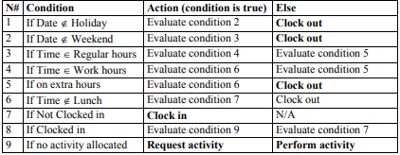
Decision making
Our agents implement a quite simple decision making mechanism using situation action rules as shown in Table

Slide 27
SYSTEM DYNAMICS SIMULATOR
System dynamics modelling is mainly a task of defining a system in terms of levels (stocks) and rates (flows) and eventual feedbacks. Given the purpose of our model, which is to estimate required effort and output quality, we found it most appropriate to use the artefact as our main level, with performance and quality being two independent rate

Slide 28
Model prerequisites
If we are to objectively compare SD to MABS we need to integrate our SD model with our performance (EPM) and knowledge models (HKM) just like we did for the MABS simulator. Performance rate will therefore be calculated using the EPM model, however it will represent an average of all participants, as our SD model only supports average developer performance and quality in contrast to the MABS model that is designed around the individual developer and its individual characteristics. Similarly quality of contributions will be based on an average of the quality abilities of all participants. A refinement we are introducing is to calculate the averages based on the actual individuals who will participate in the actual phase, as opposed to using some “company-wide” average. This provides for more accurate average results, even though we could be criticized for taking an “individual-based-view” here too. In our opinion it would not be “fair” to knowingly “weaken” the predictive power of our SD model when SD itself does not formally hinder us from providing it with “accurate” information.

Slide 29
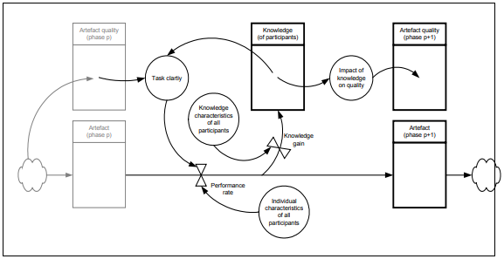
A System Dynamics Model of a development process Figure , illustrates our system dynamics model of a phase of the software development process and how it’s output artefact relates to that of the previous phase.

Slide 30
Feedback dynamics structure
Phase p+1 starts with an artefact outputted from some previous phase p. This artefact has a corresponding quality level (named artefact quality of phase p), which determines the clarity of the tasks it implies, which in turn impacts on the performance of the team. The initial performance is determined by the individual characteristics of the developers. As the team performs, their knowledge of the task at hand increases and so does the clarity of the tasks, for them, again increasing their performance. As the knowledge of the team increases, so does the quality of their artefact p+1.

Slide 31
Levels
In our SD model, artefact, knowledge and quality are three quantities that fluctuate with time and so we chose to represent these as levels. Knowledge however is a level that can only increase with time. Although inactivity could negatively impact on knowledge HKM does not provide support for this and therefore it has been left out of the model.
Flows
There are two rates of fluctuation in our SD model that we represent as flows: knowledge gain determined by our HKM using the knowledge characteristics of the team and the size of the performed task at each increment; and performance which is determined by our EPM model based on individual characteristics and task clarity.
Auxiliary variables
Other important variables are modelled as auxiliaries as they affect levels and rates based on the value of a connecting auxiliary or level, but without causing a drain in that level.

Slide 32
Difficulties
A first problem when designing the model was to account for the individual developers. Although much can be done at implementation, we did not find an obvious way to account for individual developers and their individual knowledge and performance characteristics. The actual problem resides in the static character of the model. Since knowledge and performance are inherently individual we would like these to be modelled as part of each participant. However, although it is possible to model as many participants as we want, it is not possible to “instantiate” them out of a single model, which means that participants are “hard coded” into the main SD model and therefore neither their number nor their characteristics may change from one simulation to another –without changing the SD model itself.
In a sense, SD can be seen to take a structural/procedural approach to modelling. Although SD views system behavior's to be dynamic, the structure of the system itself is made static and cannot be expected to change dynamically. We think this is the primary reason SD is more adapted to activity-based views than individual ones.
On this particular point, comparing SD to MABS reassembles comparing a procedural programming language with an object-oriented one. Although it is possible, in principle, to coerce the procedural language into object-orientation, at least somewhat, its underlying ideas belong to another paradigm.
Another problem was in using averages to represent the various characteristics of the developers. The only practical averages we could provide were those constituting IK and IC. However average IK and IC values do not result in the average performance of those persons in question. An alternative that is likely to solve this problem, is to instantiate all the required developers with their respective IK and IC values, query our EPM model for performance and HKM for knowledge levels of each developer, derive the average of these, pass them over to SD, update the abilities of each developer, query … average out … pass over… update each developer. This is possible was it not for one problem… the paradigm! By relying on a multitude of developers for which we quire individual characteristics then update each developer individually, then we are actually running a MABS simulation and not SD.

Slide 33
Implementation
To provide an objective comparison ground, ensure an exact similar use of the models, and the various necessary utilities such as calendars and clock functions we implemented the system dynamics model as a single “average” developer, running on our simulator framework, who’s individual characteristics represent an average of all participants within a phase and who’s performance is proportional to the number of developers considered for the simulation.
These characteristics being averages are no longer individual, instead they provide the variables and constants that our SD model needs (directly or derived).
A reason why this platform “reuse”, provided by our simulator framework, is possible, is that although it could be recommended, there need not be a one to one mapping between a model and its implementation if there is another possible implementation that remains true to the model. What is important in our case is that the single average developer implementation preserves all the characteristics of our SD model. Indeed this is true because in our simulation platform artefacts cumulate contributions from the developer(s), which are quantified and qualified. And as contributions are added, knowledge gains of the developer(s) are updated in separate levels as defined in our SD model. These results in an integral over contributions, which is what our SD levels mathematically represent.

